Slide 1
Putting genetic variation on the map
conStruct
tess3r
spaceMix
EEMS
Un-PC

Slide 2
Are there really barriers to migration, or is it just increased divergence over increased distances?
Idotea baltica
admixturePlotting_v5.R

Slide 3
PCA rarely recapitulates maps. “Horseshoe” is a typical artifact of divergence increase with distance.
Idotea_2019 “NC” – no clones (idotea_ibs620_noclones2.R)

Slide 4
Without outlying individuals (SYL, a couple of TJA)

Slide 5
Let’s just visualize our clusters on a map to get an intuition of what might be going on
Idotea baltica
admixturePlotting_v5.R

Slide 6
tess3r

Slide 10
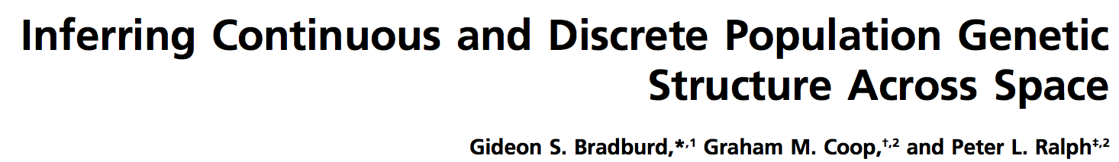
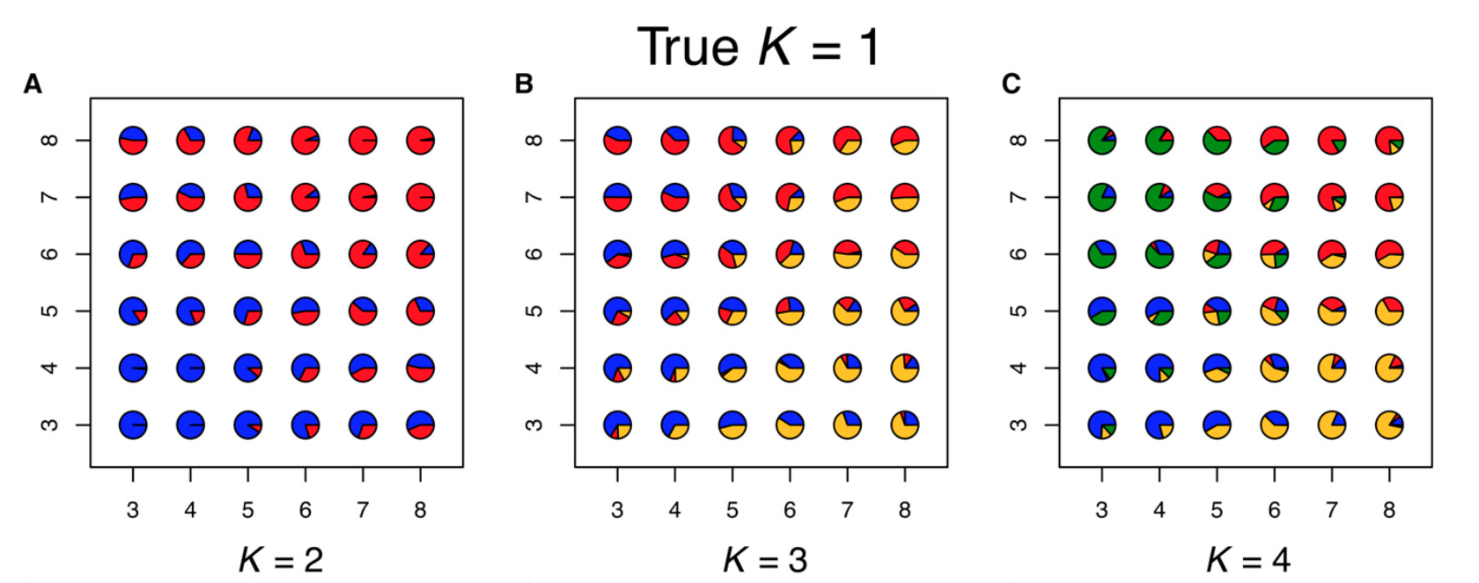
Continuous vs. discrete differentiation
Gradual accumulation of genetic divergence with distance looks (to ADMIXTURE) like emergence of separate genetic clusters
ADMIXTURE
The problem is to tell the difference from situations where we have abrupt bariers to gene flow.

Slide 11
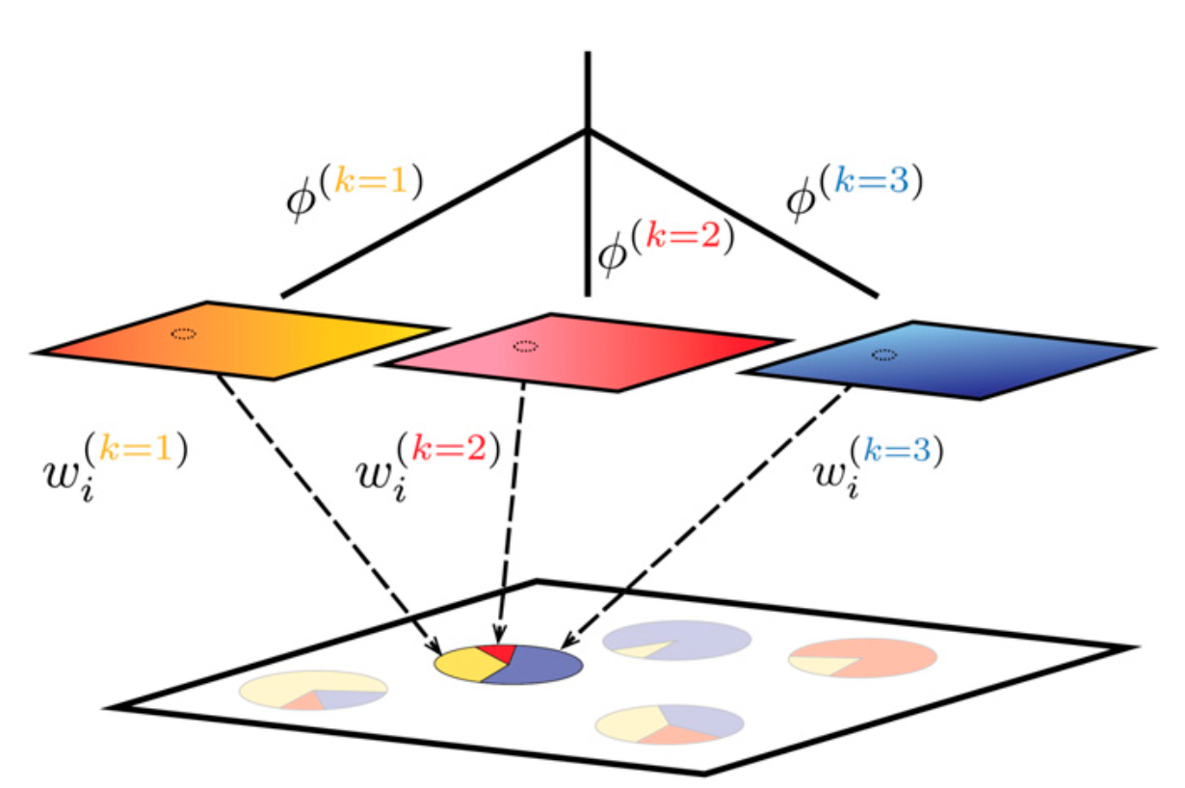
Continuous vs. discrete differentiation
conStruct
Let’s imagine that we have several “layers” (analogous to “ancestral components” of ADMIXTURE) in each of which genetic divergence accumulates with distance, and these “layers” are mixed in different proportions in each individual.
Gradual change in allele frequencies → within the same ”layer”
Abrupt shift in allele frequencies → switch between “layers”
Notes:
Figure 1 Schematic of our method, using K 1⁄4 3 as an example. Spatial
autocorrelation of allele frequencies within each layer is depicted by color
gradients, and fðkÞ denotes the covariance shared by samples with an-
cestry entirely in the kth layer. Sampled populations on the landscape are
inferred to be admixed between these layers; the ith sample draws pro-
portion wðkÞ of its ancestry from layer k. For convenience, each layer is i
depicted as a small square, but in fact, each layer exists everywhere in the sampled area, so the small dashed circles on each layer show where the location of the highlighted admixed sample intersects each layer.

Slide 12
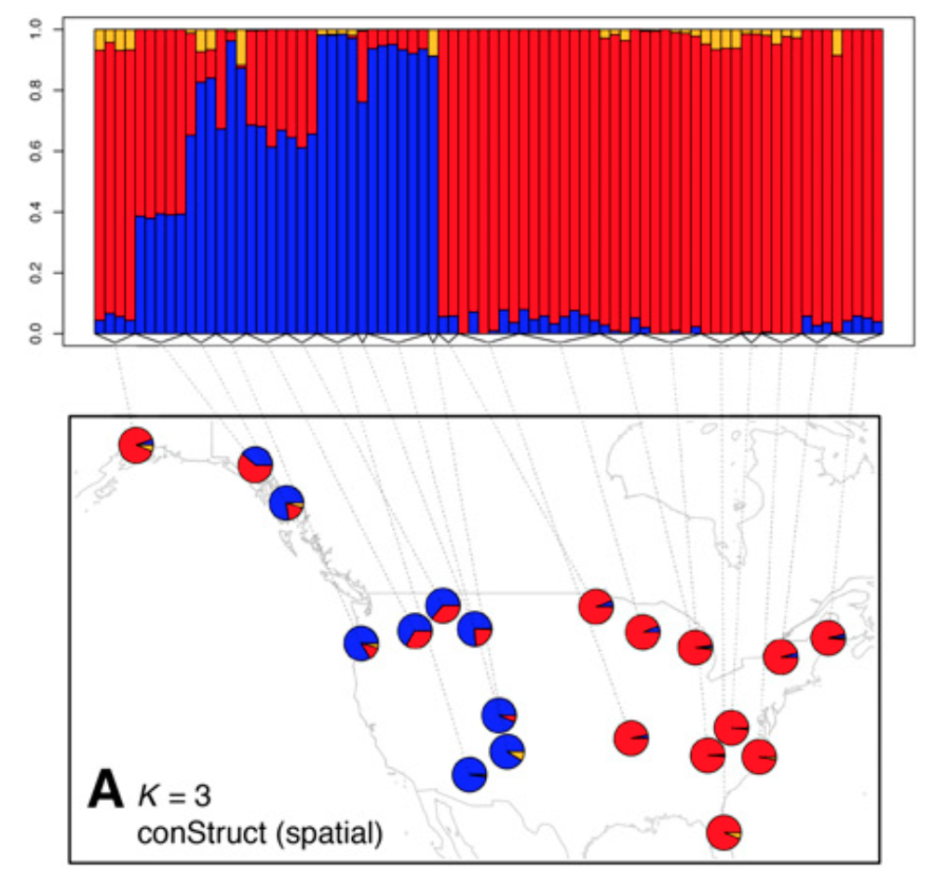
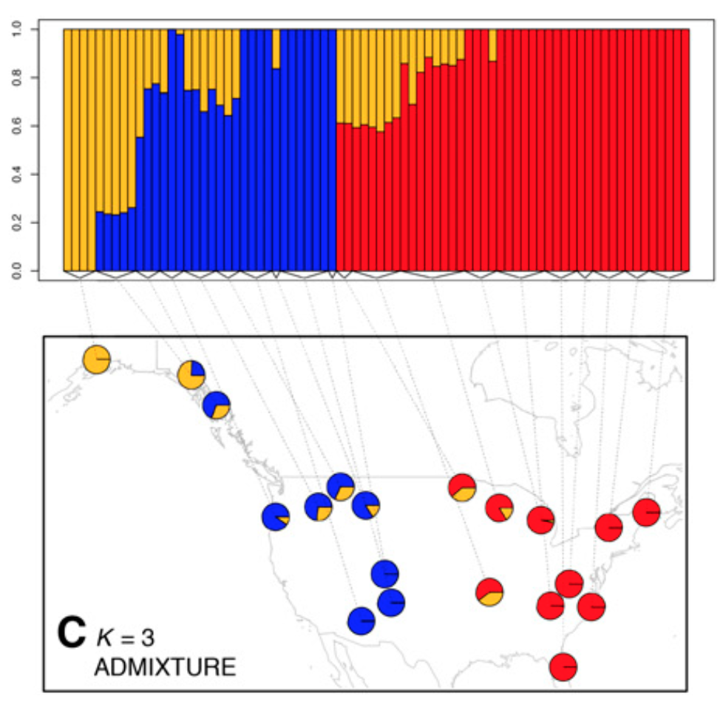
Black bears
conStruct infers two “layers”, while ADMIXTURE regards far-flung bear populations of the “red” type as a separate genetic cluster.

Slide 13
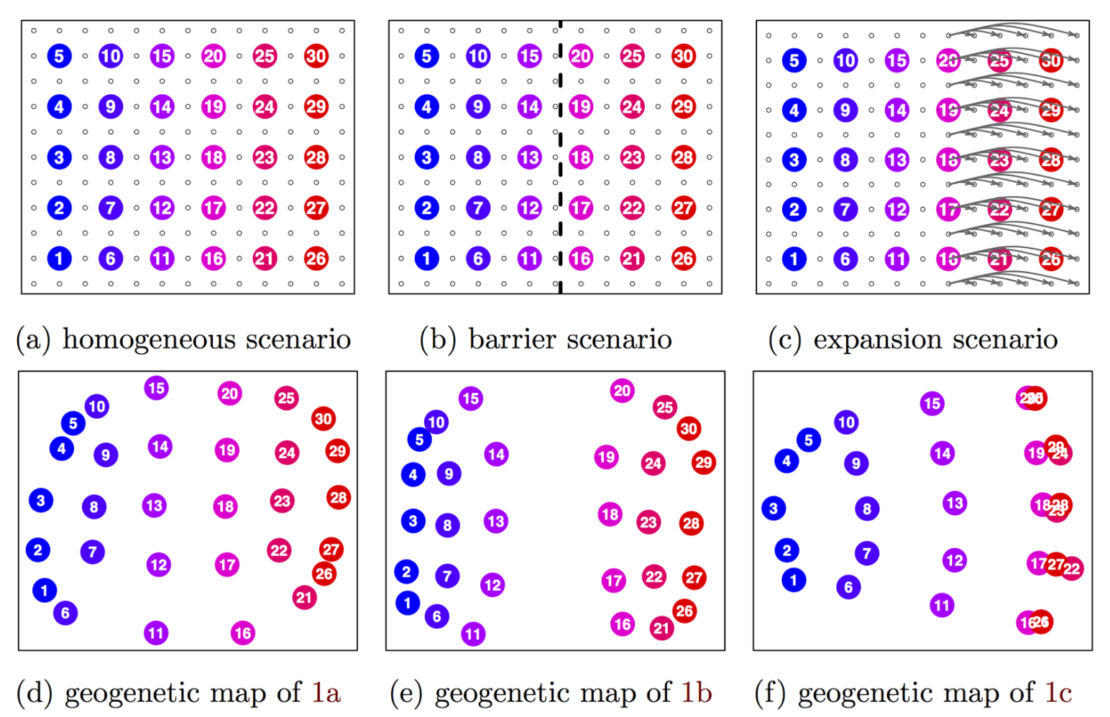
the pattern of genetic relatedness between the samples is represented by a map, in which inferred distances between samples are proportional to their genetic differentiation, and long distance relatedness (in excess of that predicted by the map) is modeled as genetic admixture.
SpaceMix
https://doi.org/10.1371/journal.pgen.1005703
Notes:
produces a map of the geo- graphic positions of the populations, but with distances distorted to reflect historical rates of gene flow. In the underlying model, allele frequency covariance is a decreasing function of geogenetic distance, and nonlocal gene flow such as admixture can be identified as anoma- lously strong covariance over long distances. This admixture is explicitly co-estimated and depicted as arrows, from the source of admixture to the recipient, on the geogenetic map.

Slide 14
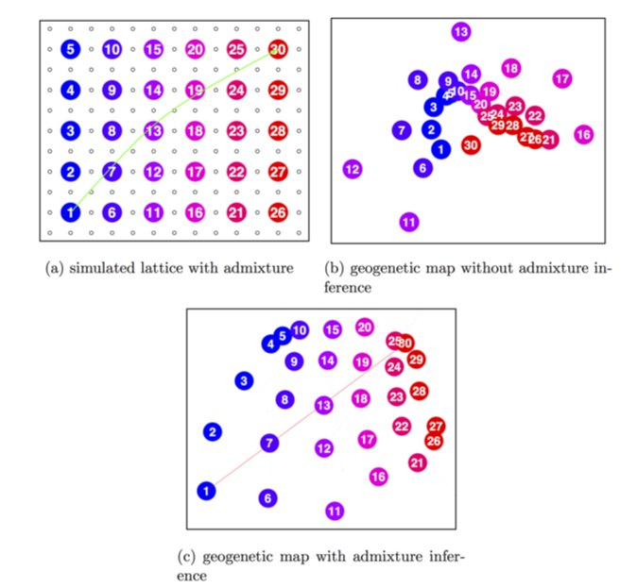
SpaceMix: detects of one-time long-distance migration events
Notes:
produces a map of the geo- graphic positions of the populations, but with distances distorted to reflect historical rates of gene flow. In the underlying model, allele frequency covariance is a decreasing function of geogenetic distance, and nonlocal gene flow such as admixture can be identified as anoma- lously strong covariance over long distances. This admixture is explicitly co-estimated and depicted as arrows, from the source of admixture to the recipient, on the geogenetic map.

Slide 15
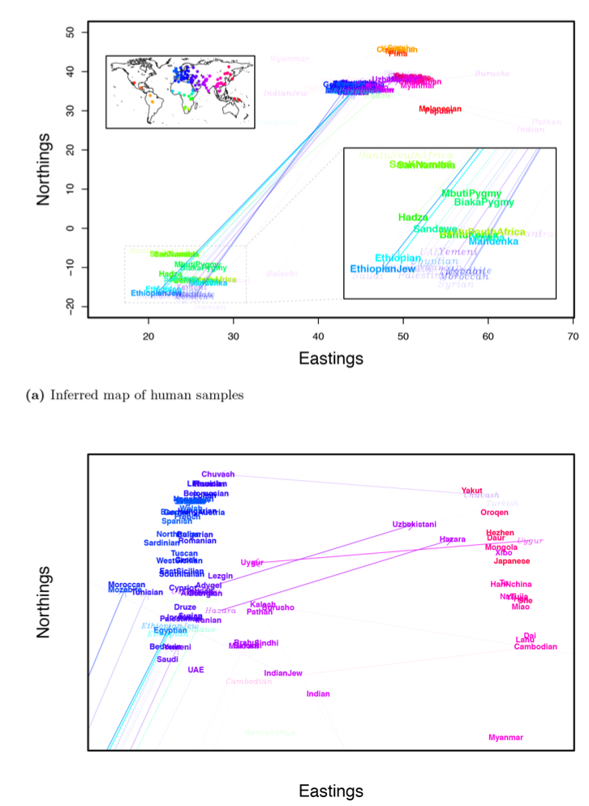
SpaceMix can get rather confusing with real data

Slide 16
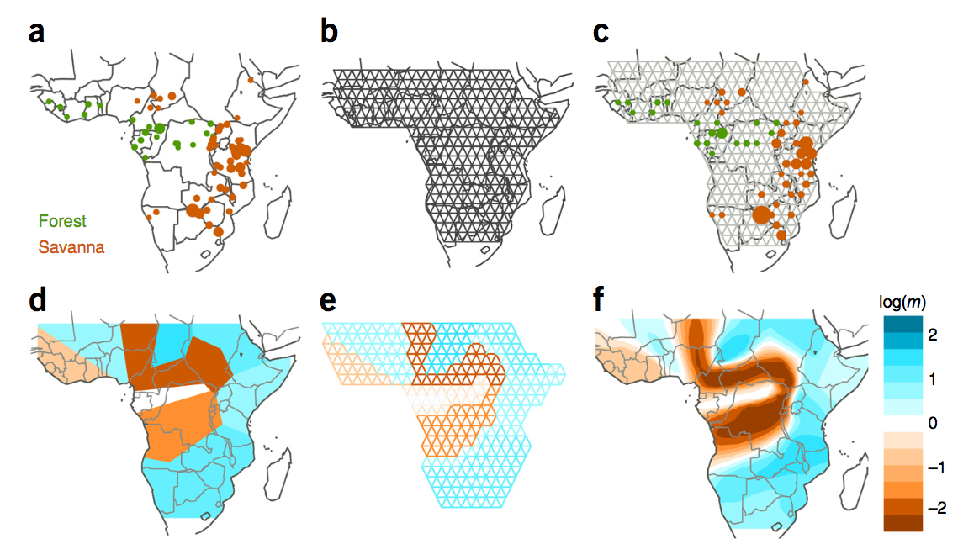
EEMS: quantifies barriers to migration between neighboring points in space
Looks for places on map where the rate of divergence accumulation with distance either speeds up or slows down

Slide 17
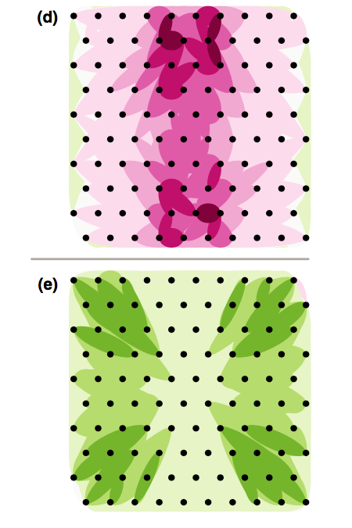
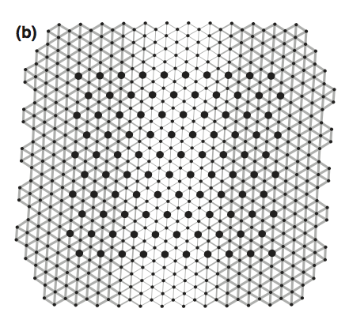
Un-PC: nice simple idea – let’s just plot higher-than-expected (given distance) or lower-than-expected pairwise divergences between populations as colored ellipses
Simulated migration rates
Lower migration
Higher migration

Slide 18
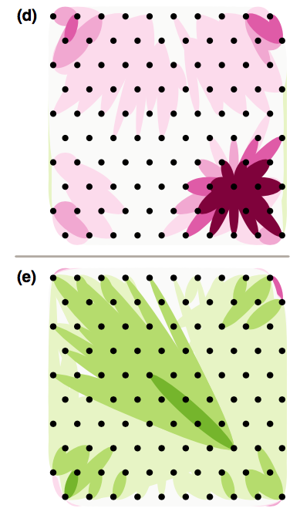
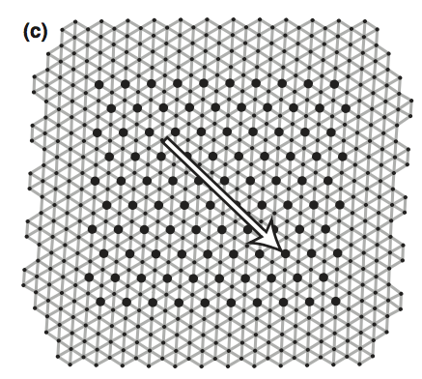
Lower migration
Higher migration

Slide 19
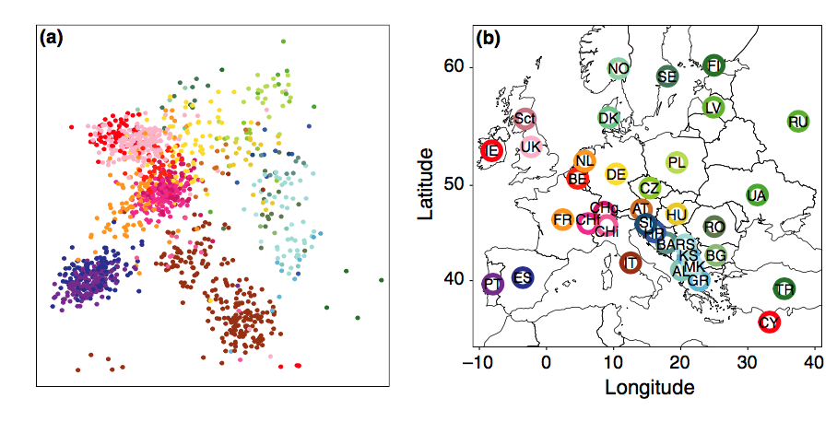
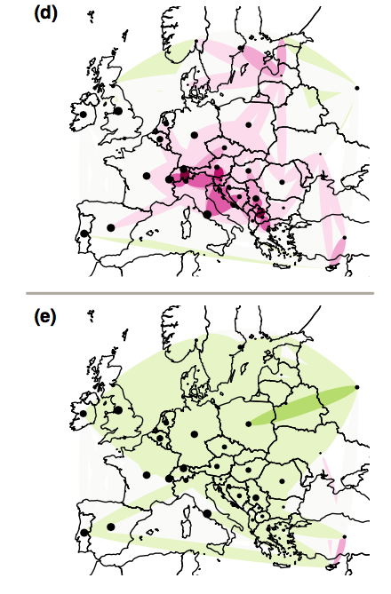
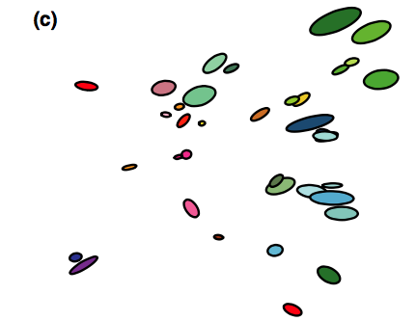
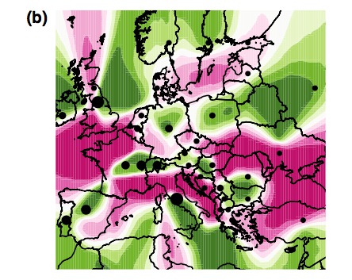
Un-PC
Lower migration
Higher migration
spacemix
EEMS

Slide 20
tess3r

Slide 21
un-PC (only clones removed)

Slide 22
Un-PC, after removing clones and highly dissimilar pops (SYL and FIS)
Notes:
unPC_visualization_unPC_outputPlot__Iteration_#1_mostDiffOnTop_017.pdf
unPC_visualization_unPC_outputPlot__Iteration_#1_leastDiffOnTop_017.pdf

Slide 23
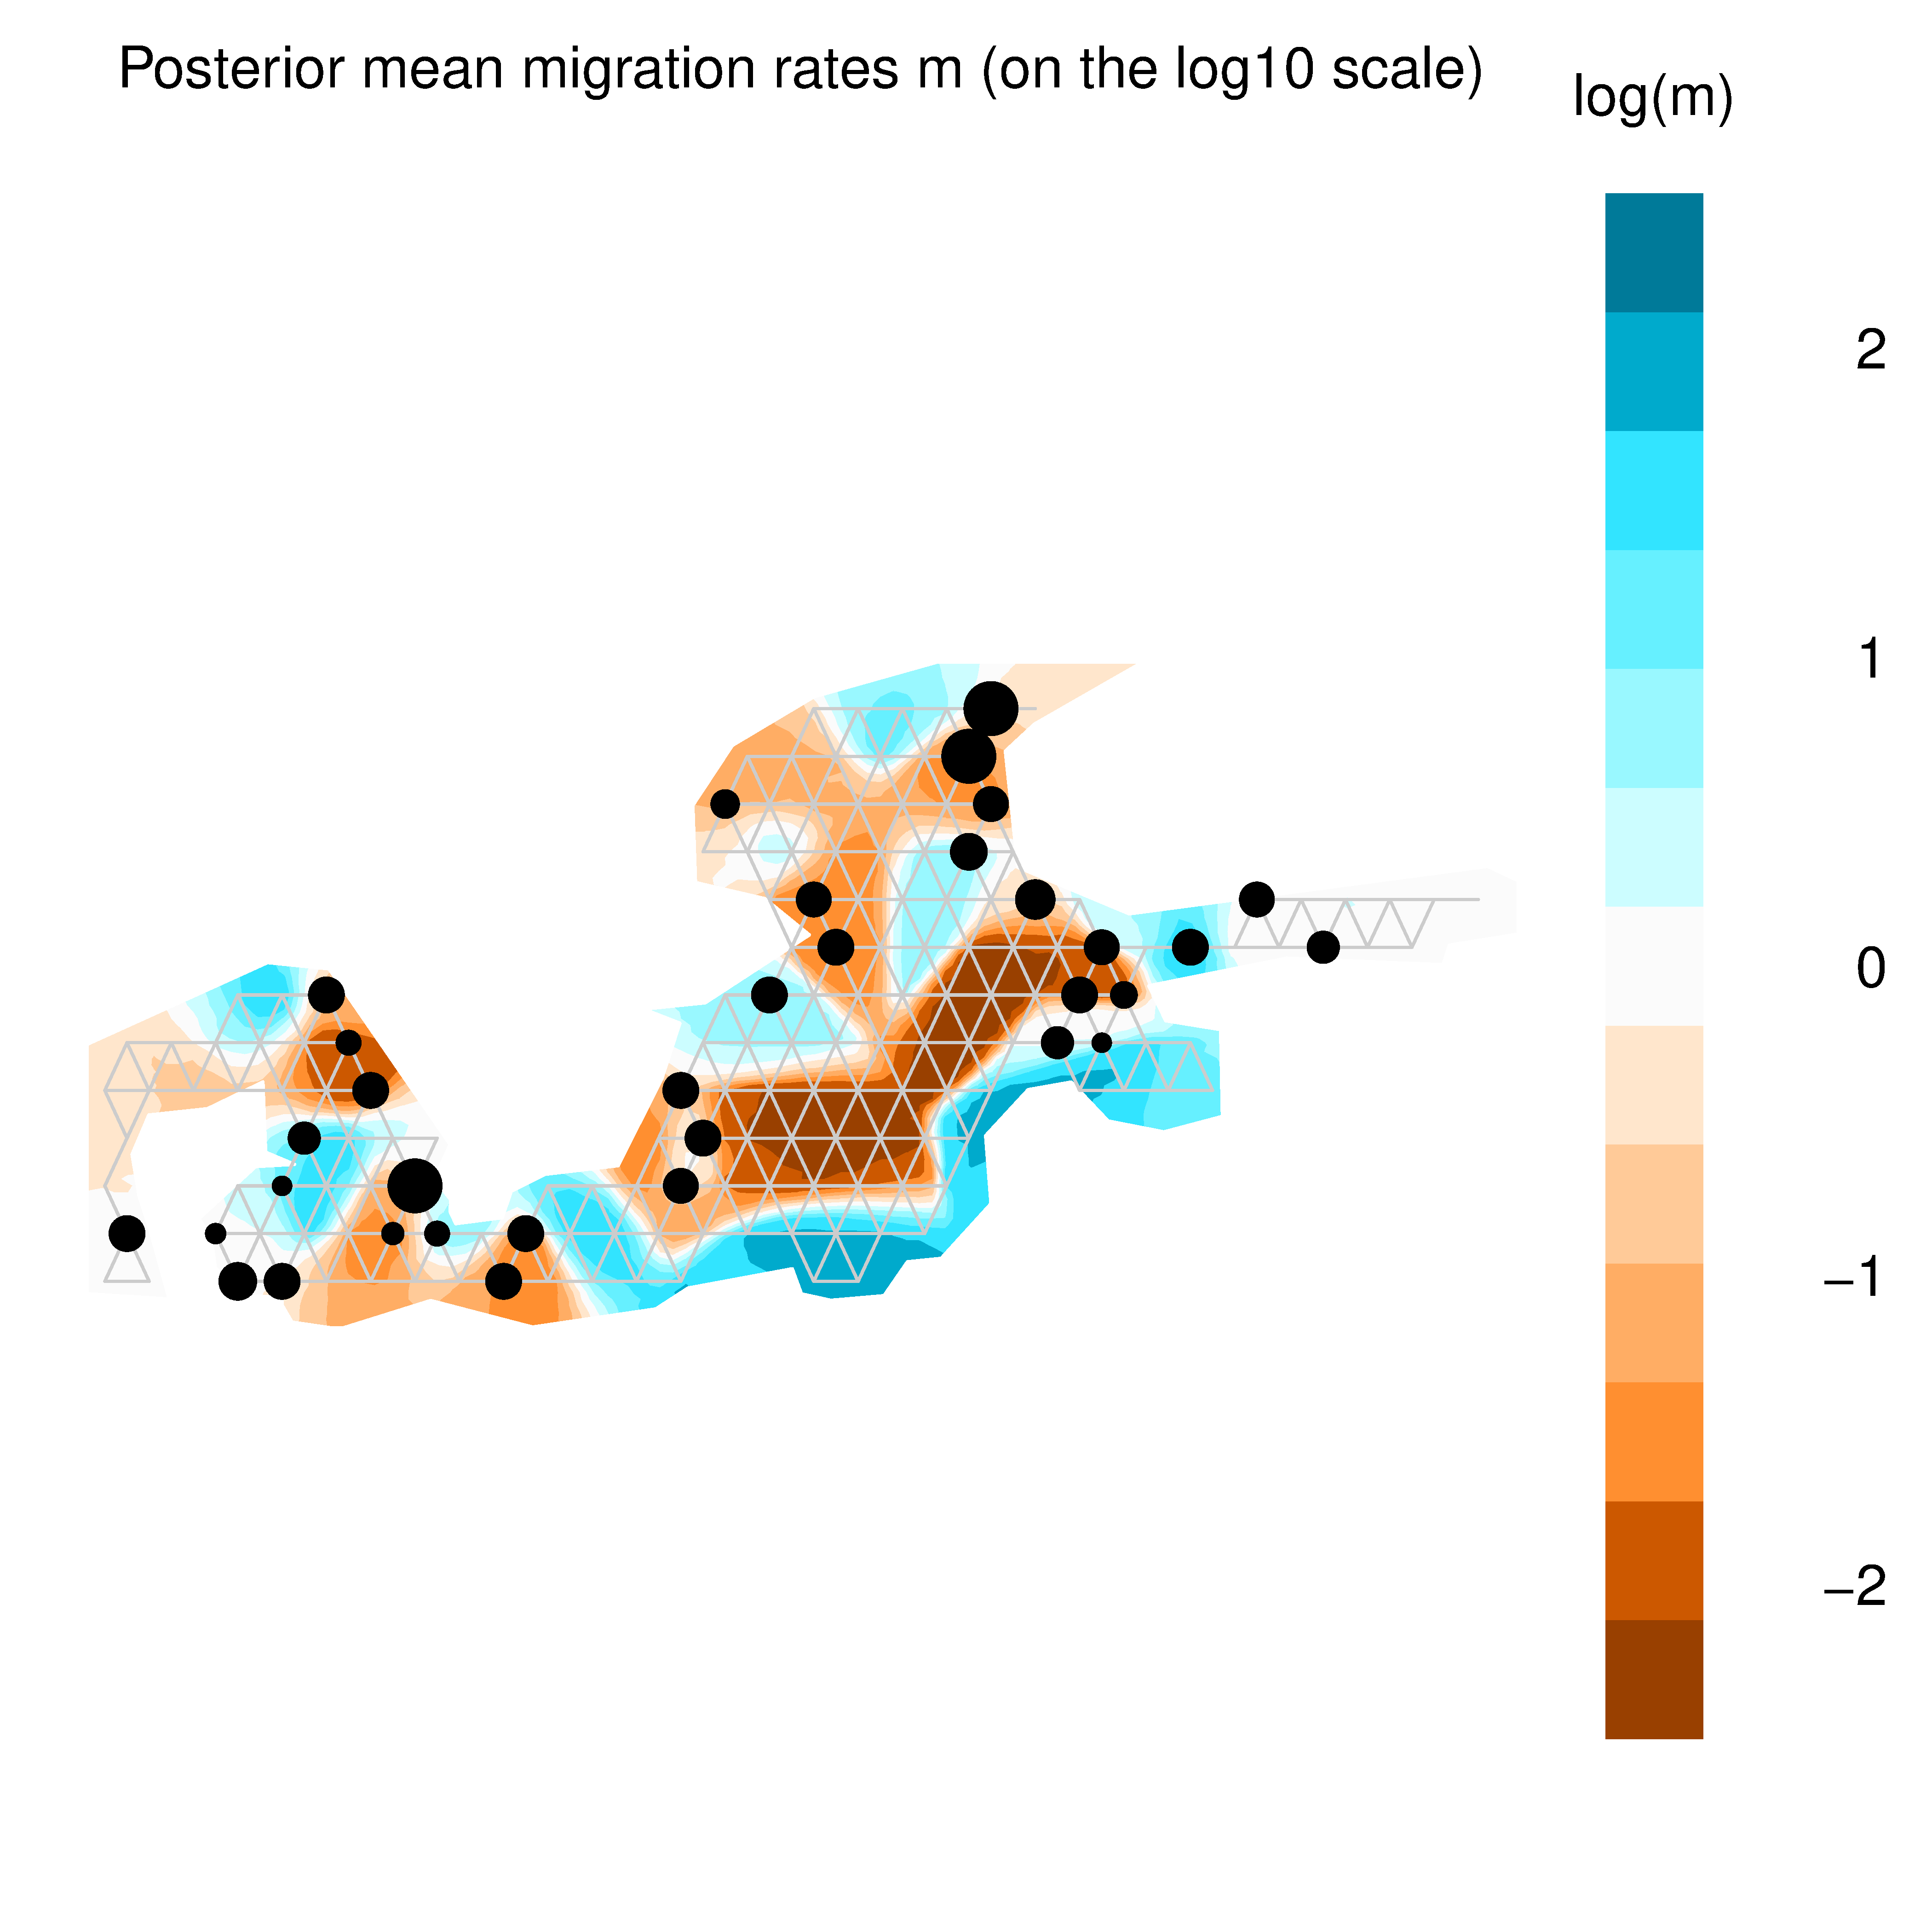
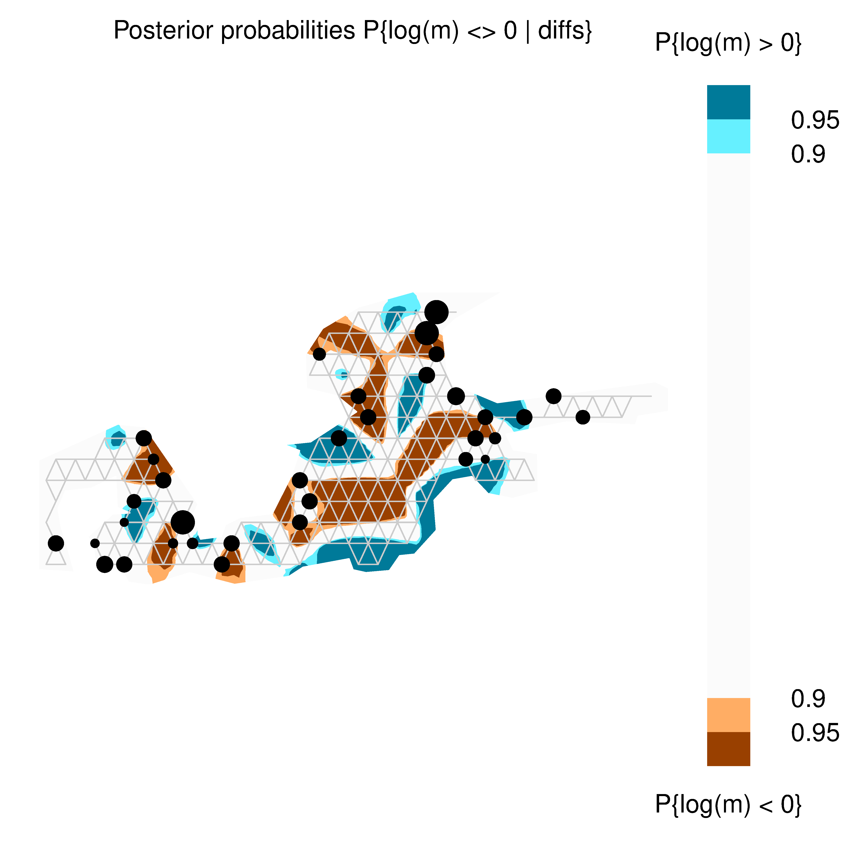
Notes:
/mega2019/idotea_2019/idotea_eems/iNC3

Slide 24
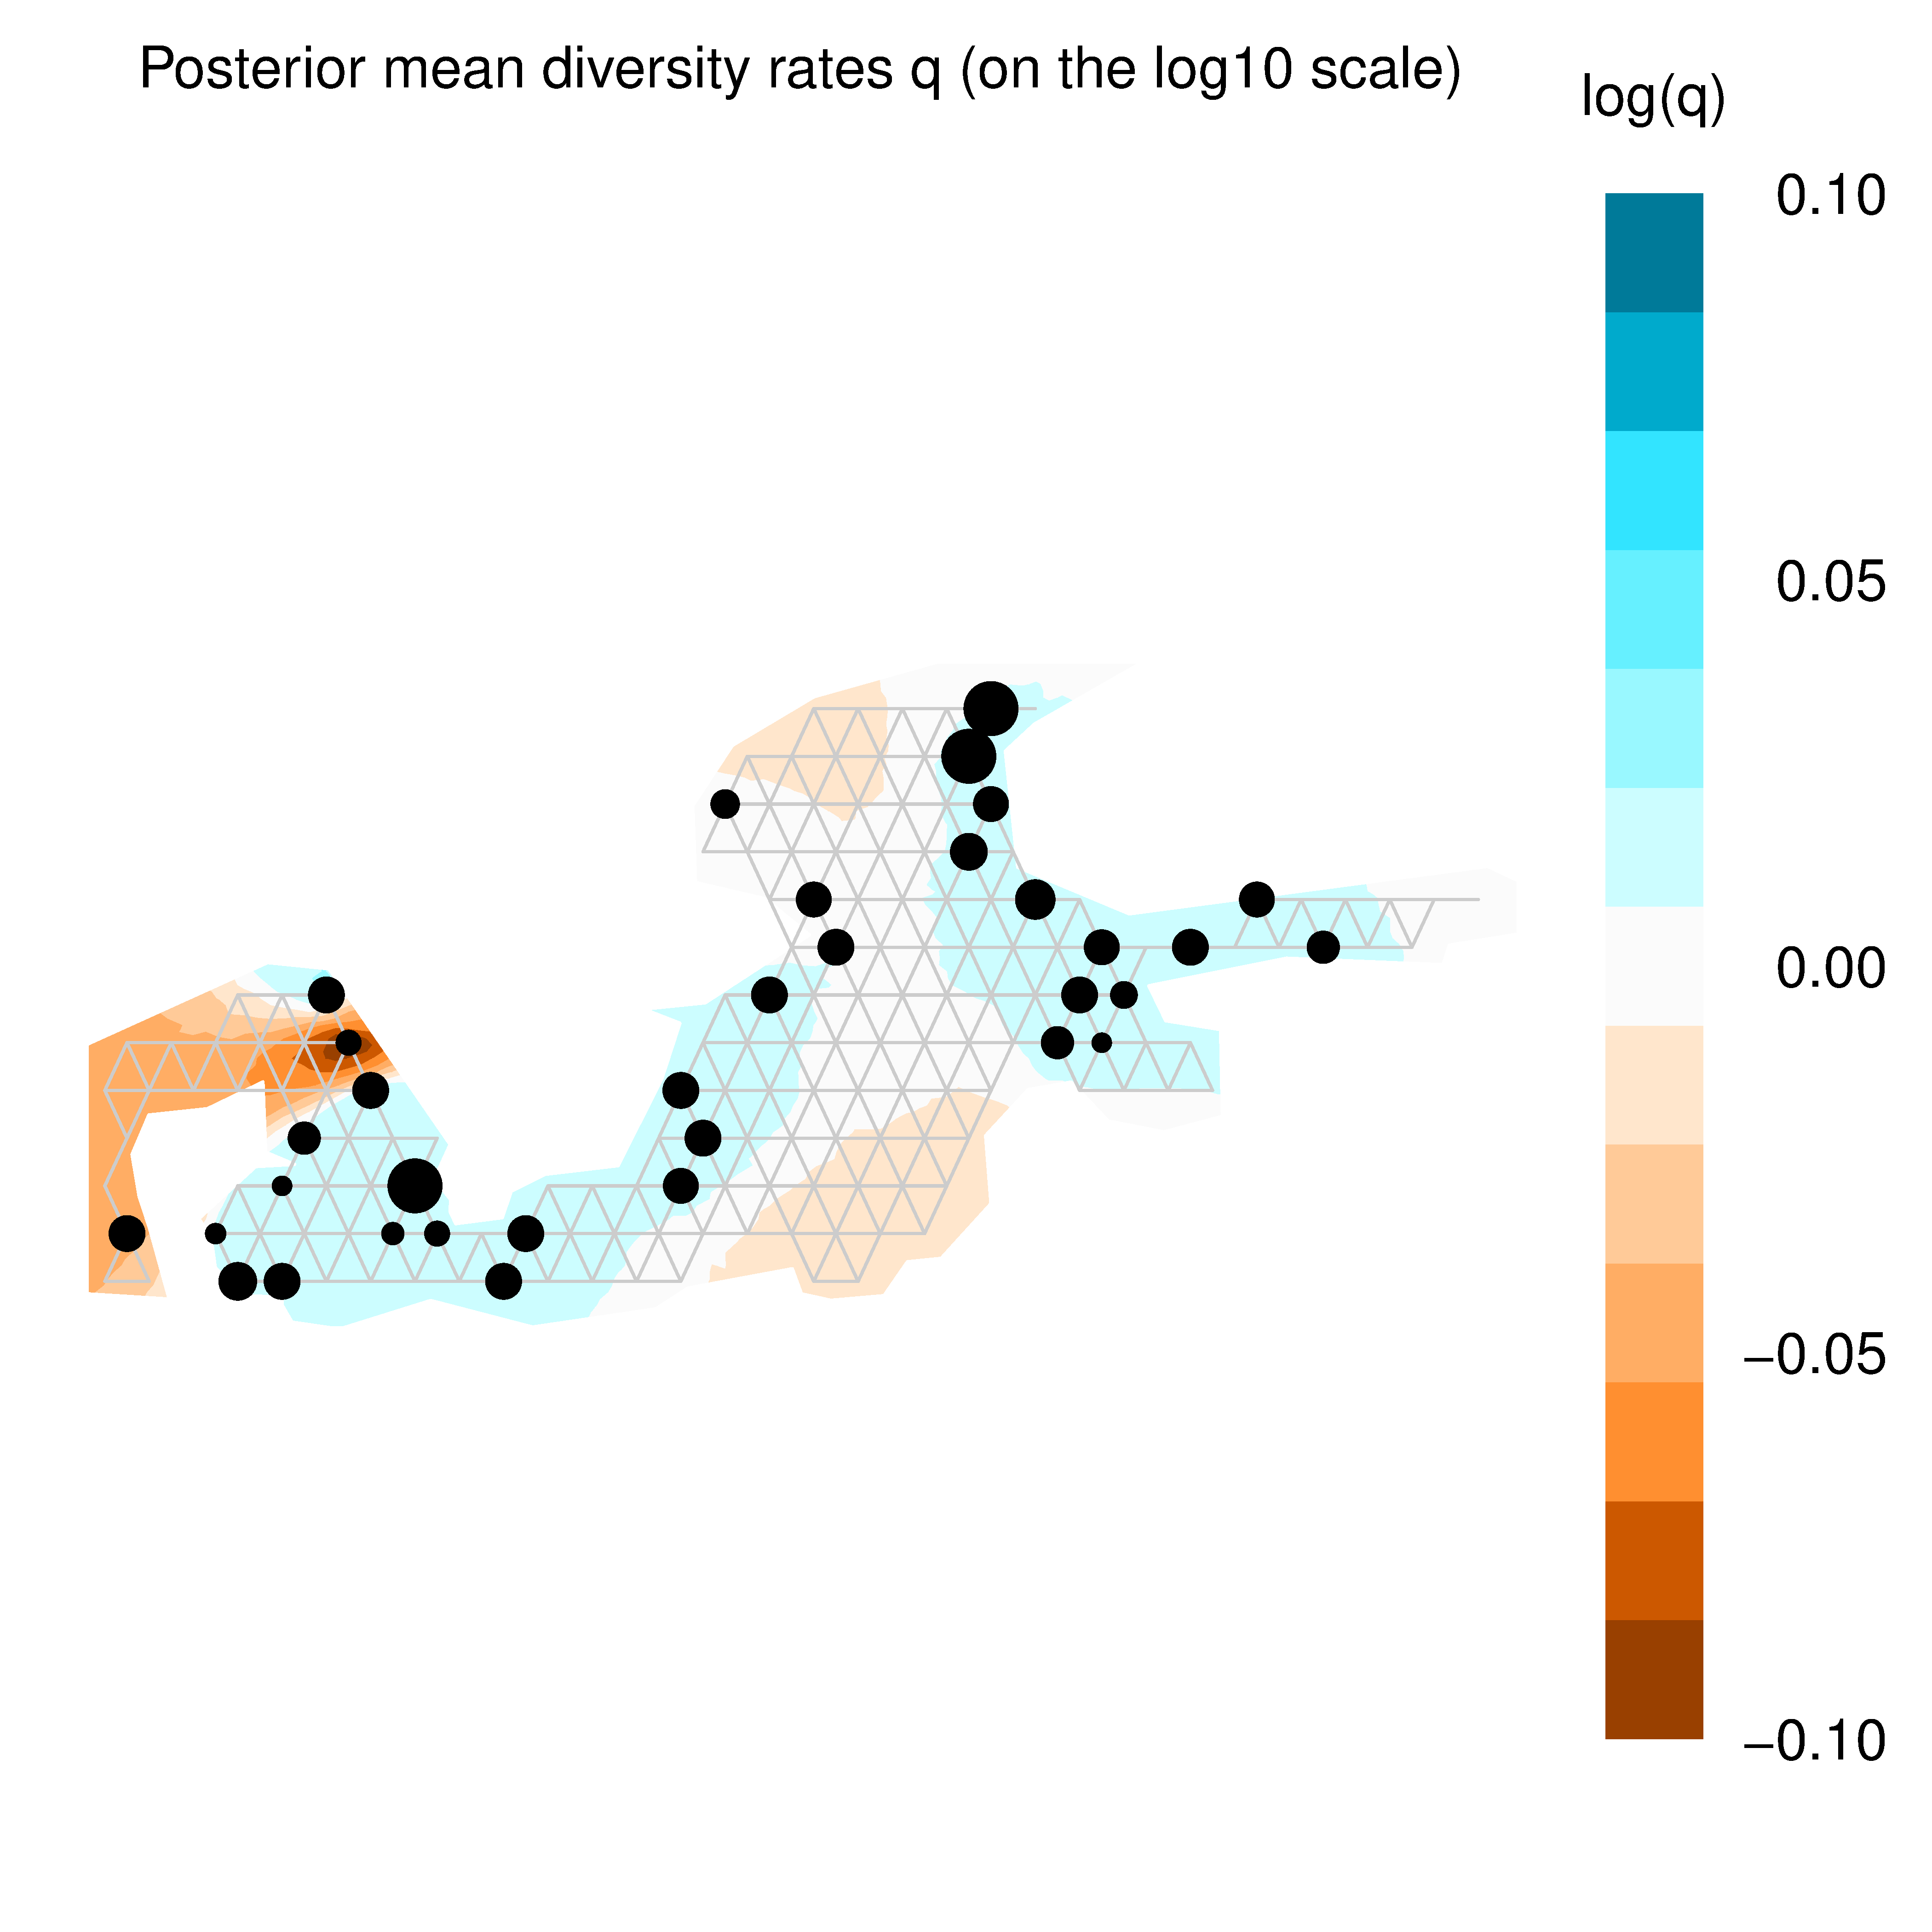
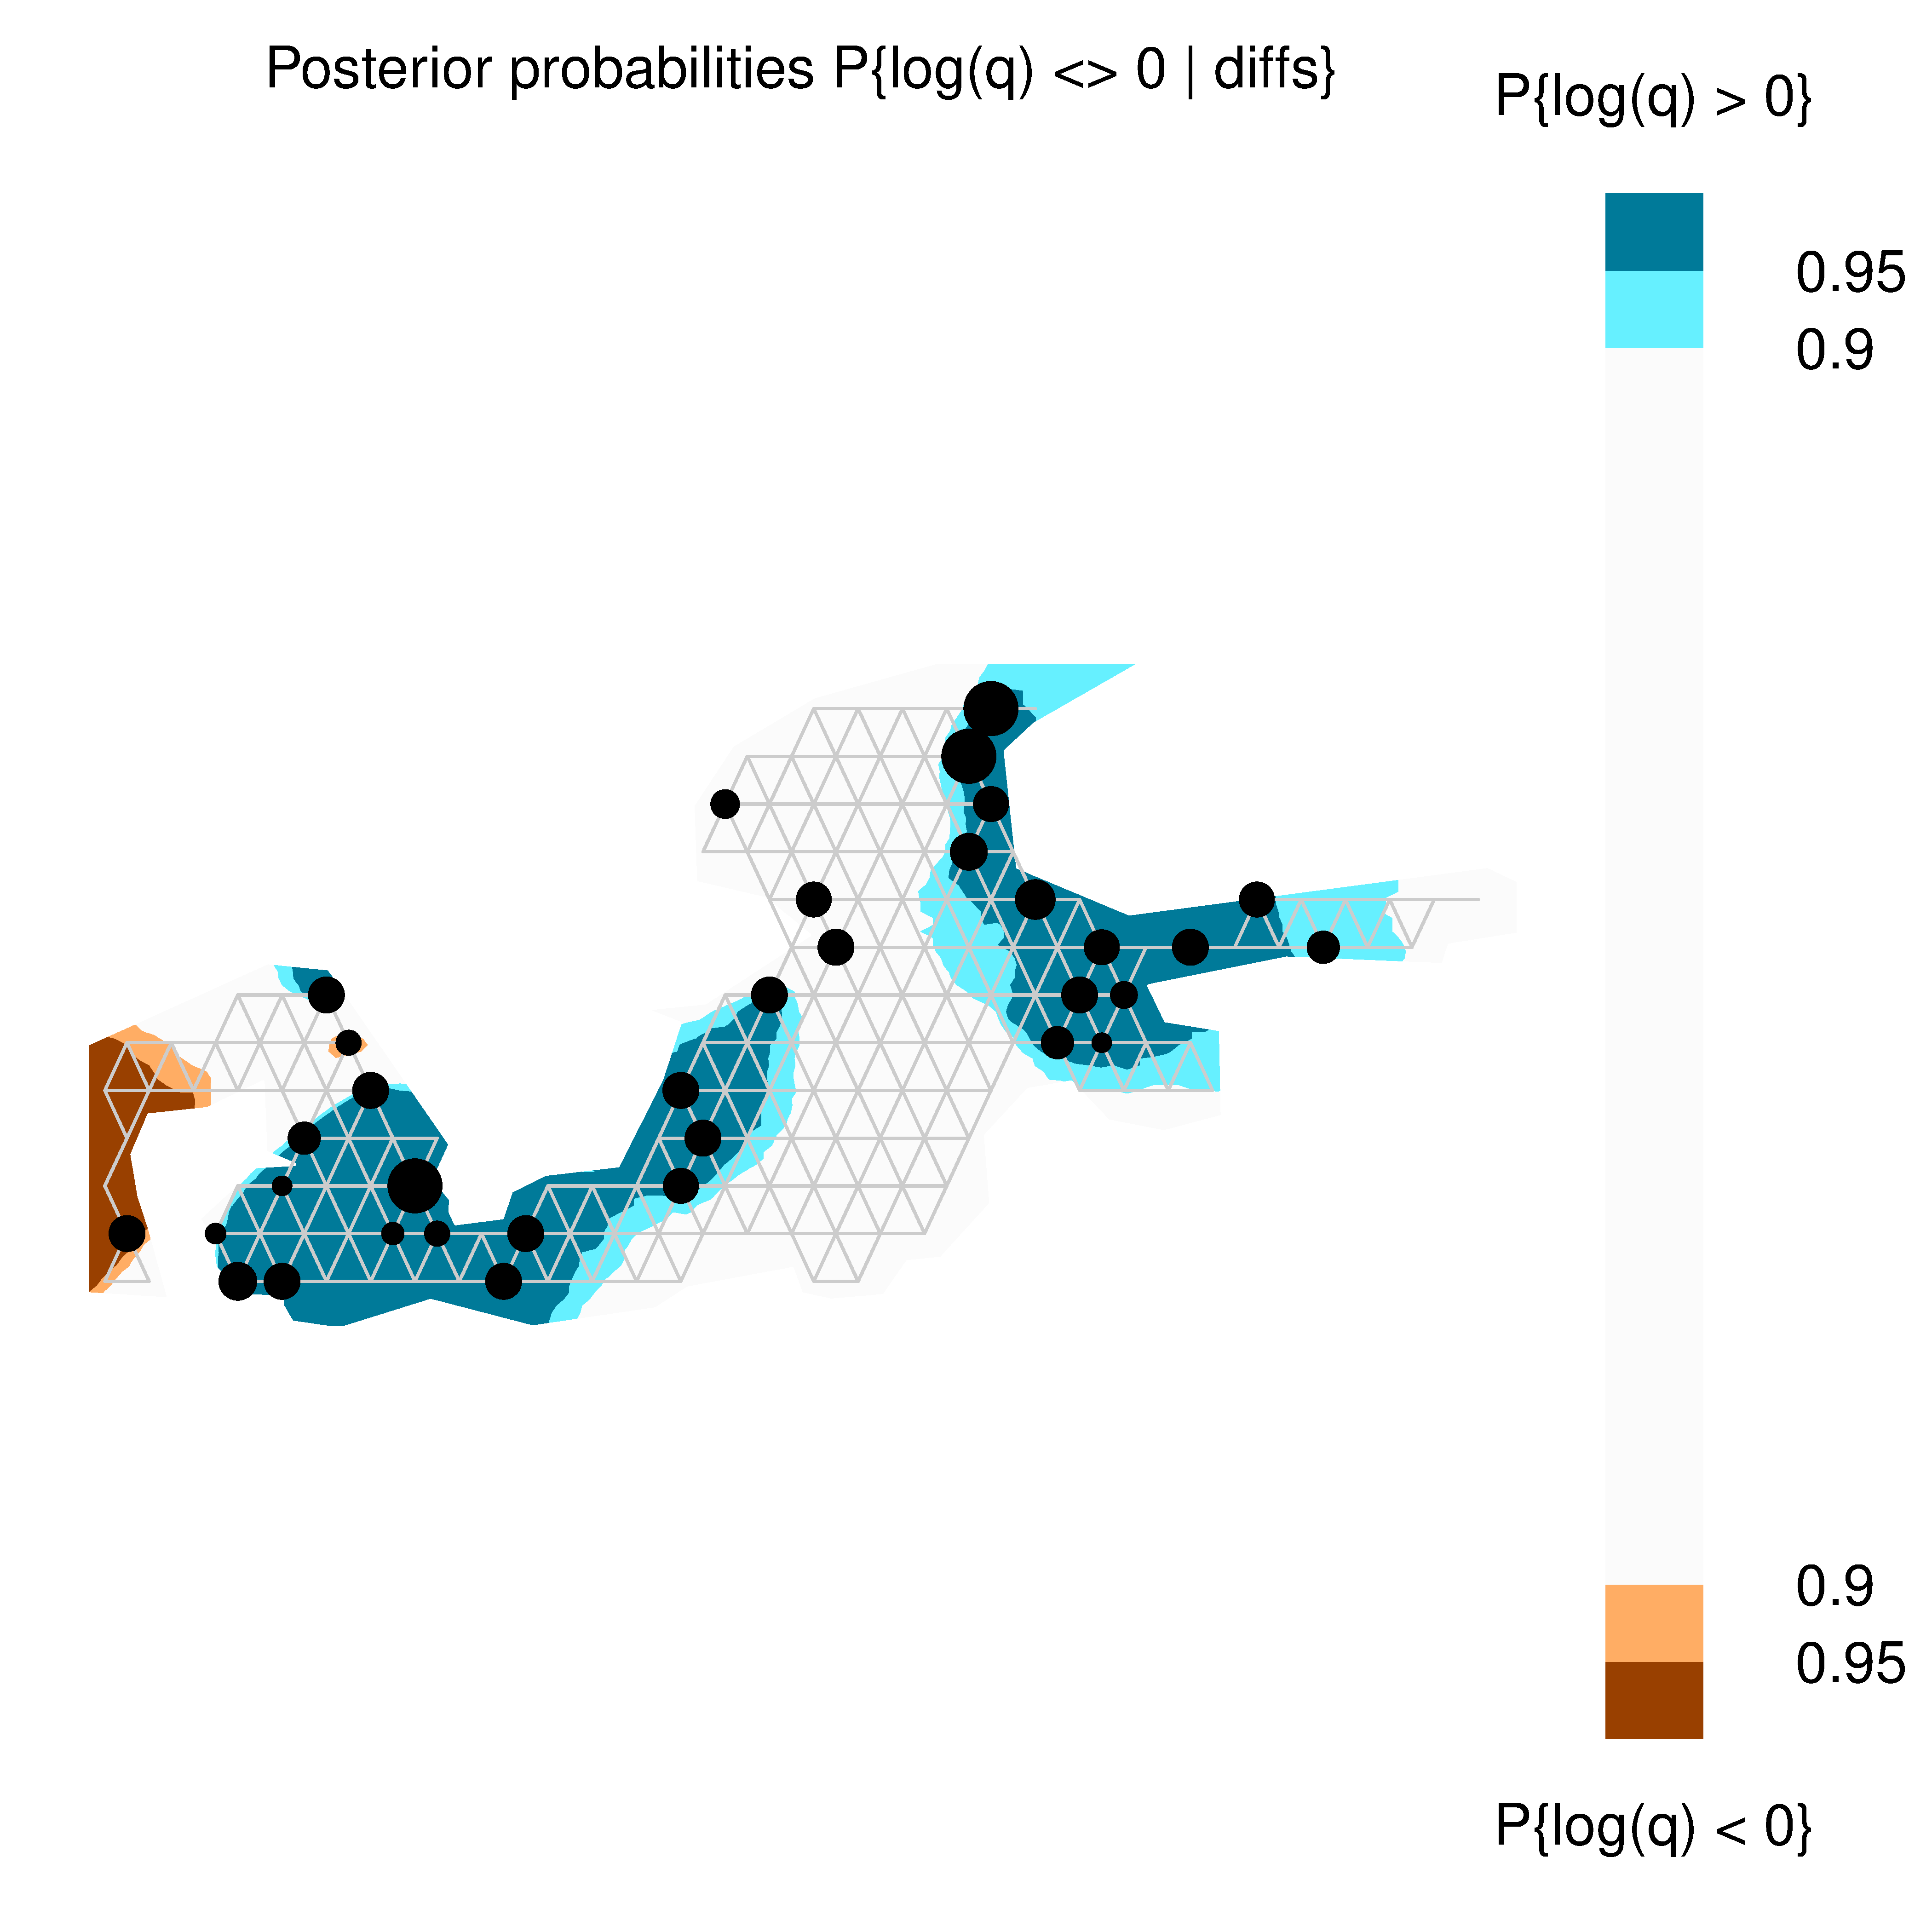
Notes:
/mega2019/idotea_2019/idotea_eems/iNC3

Slide 25
z
z
FIS
SYL
FIS
SYL
SYL, FIS: Low-diversity populations

Slide 26
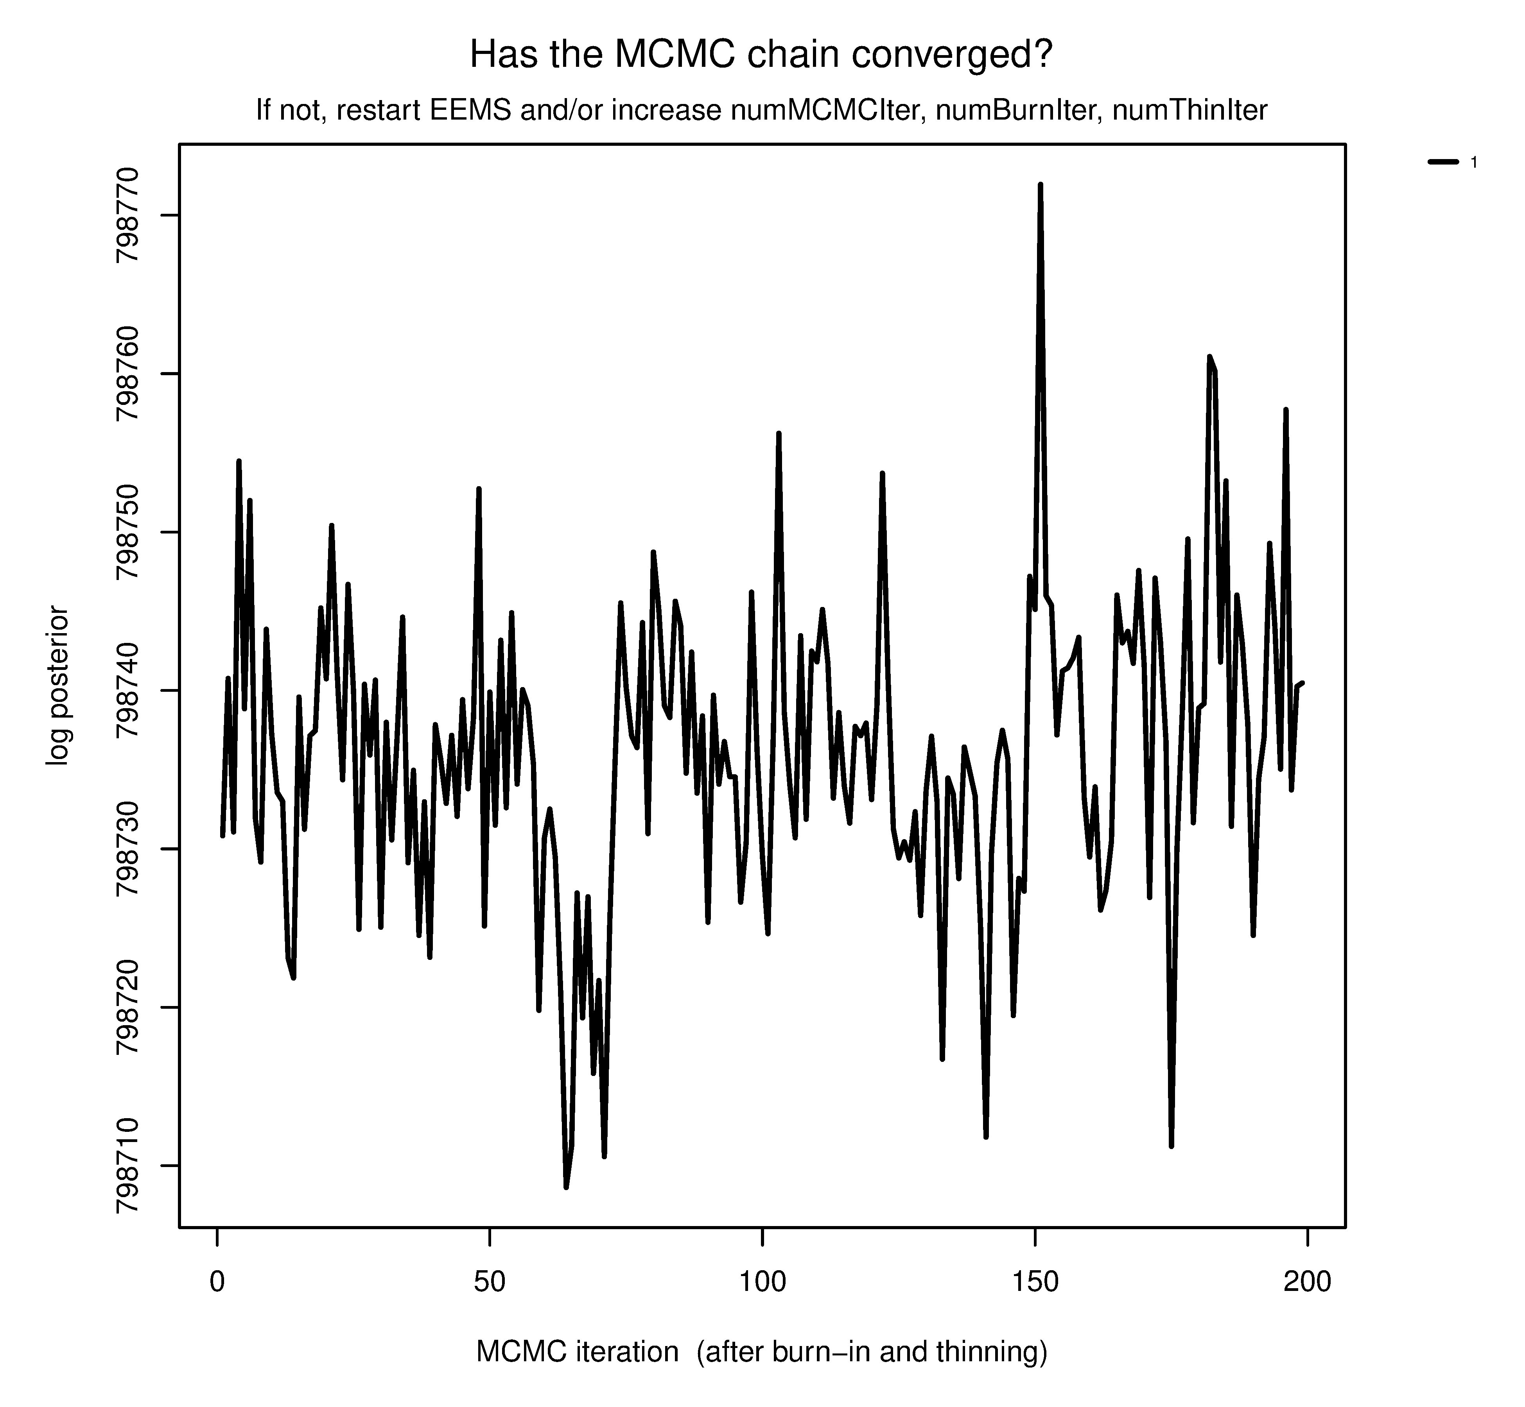
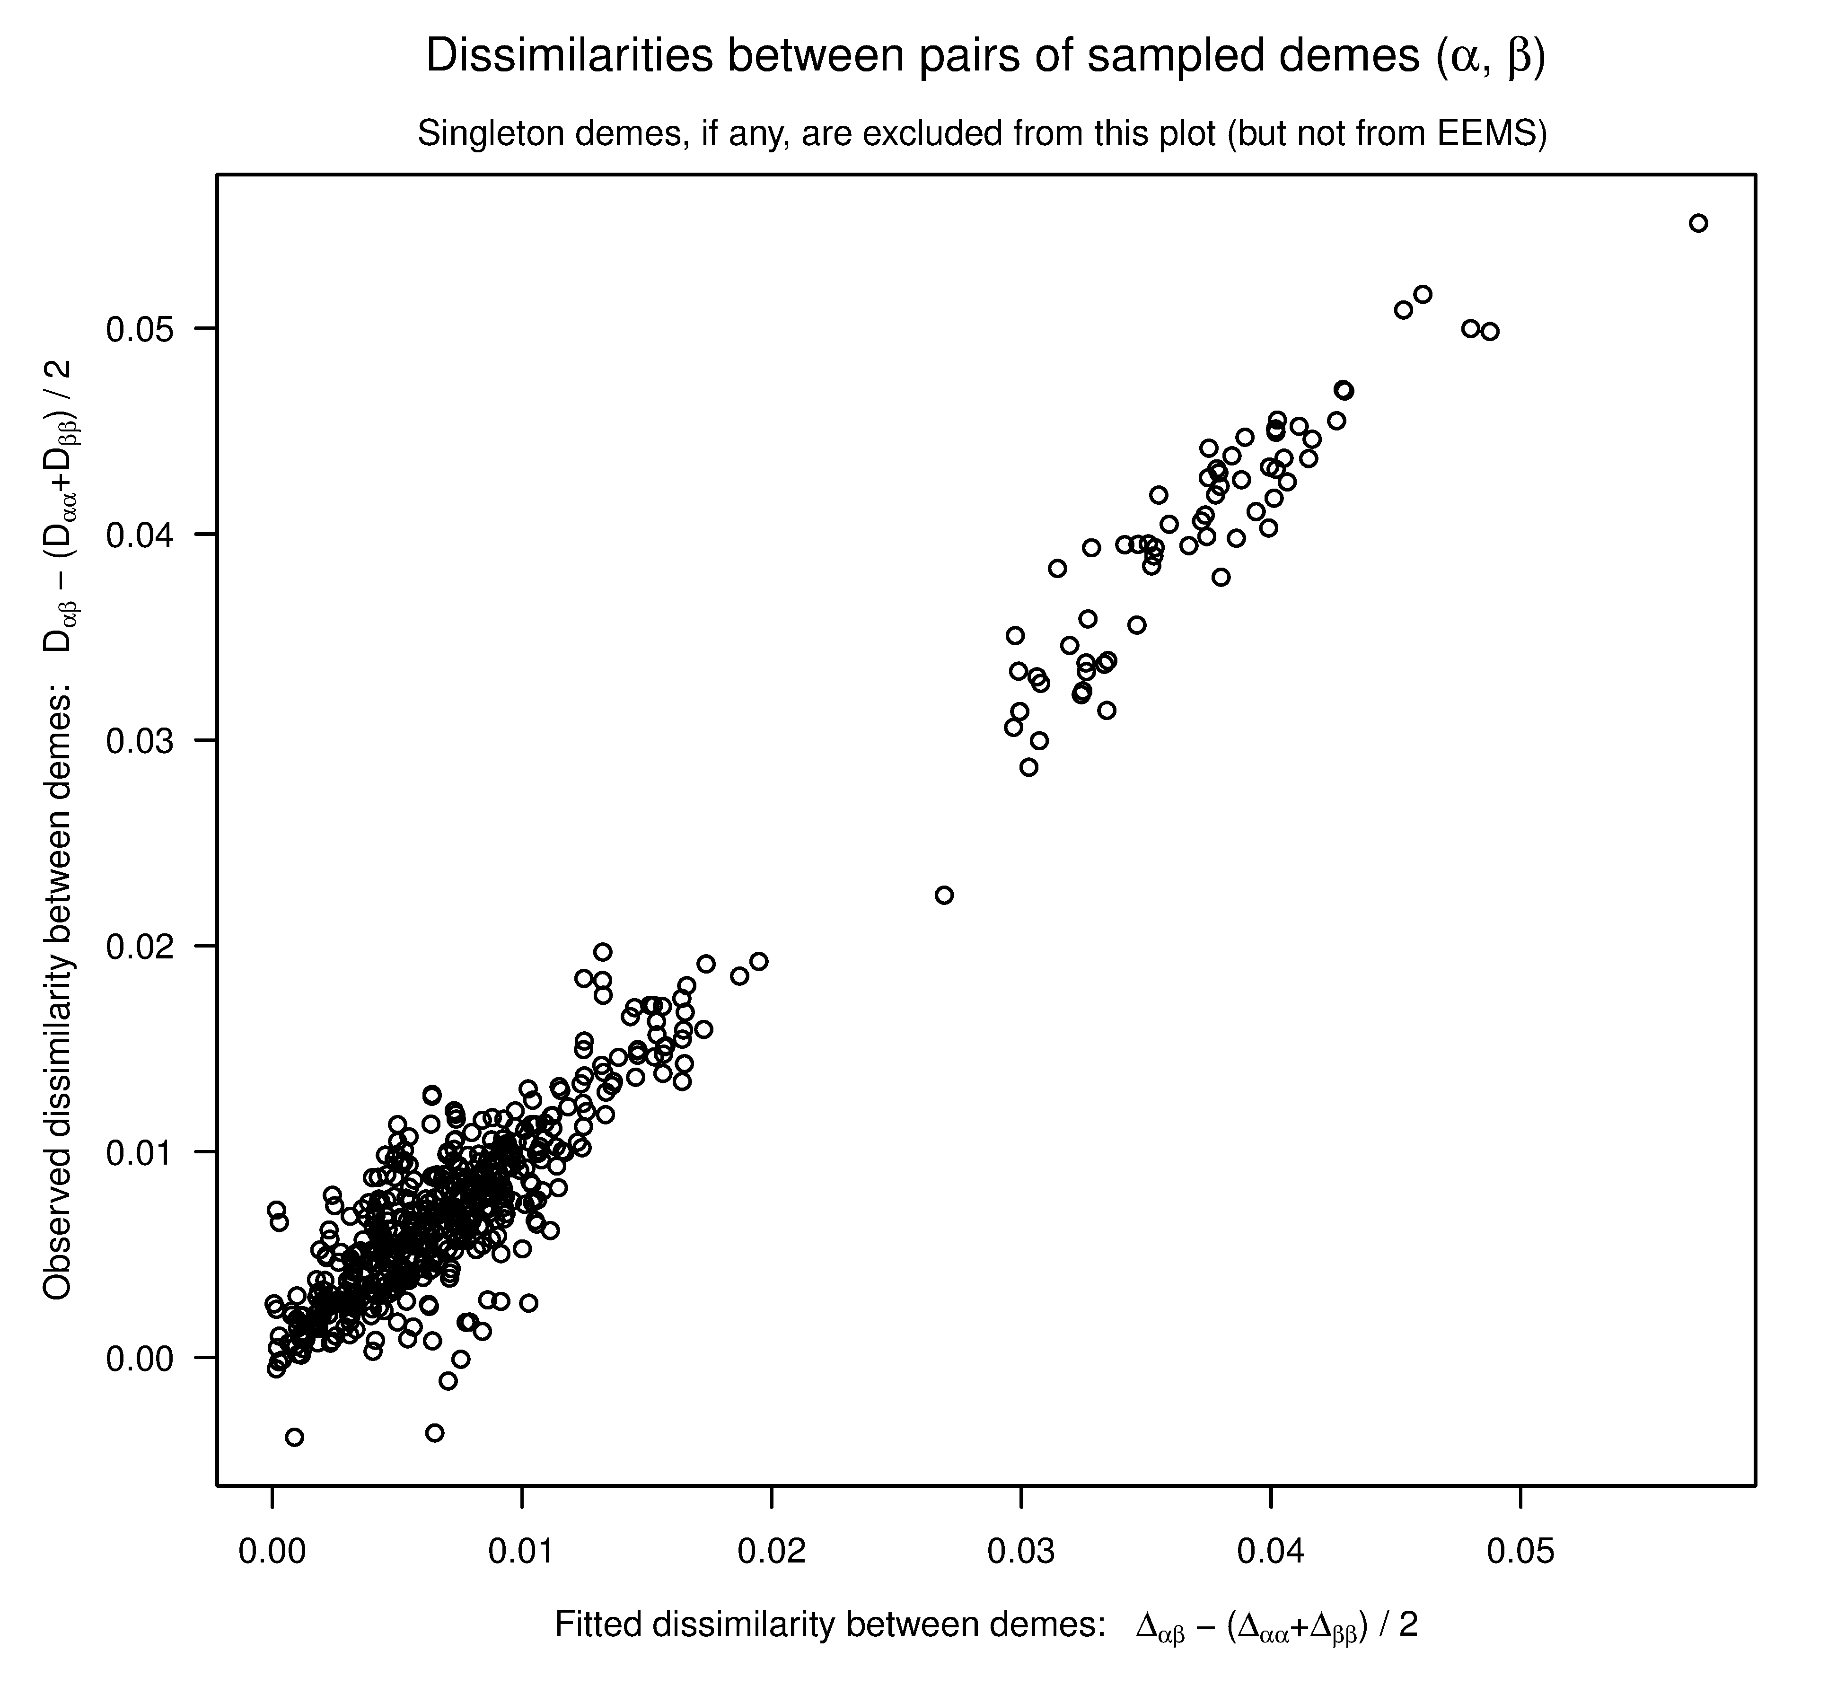
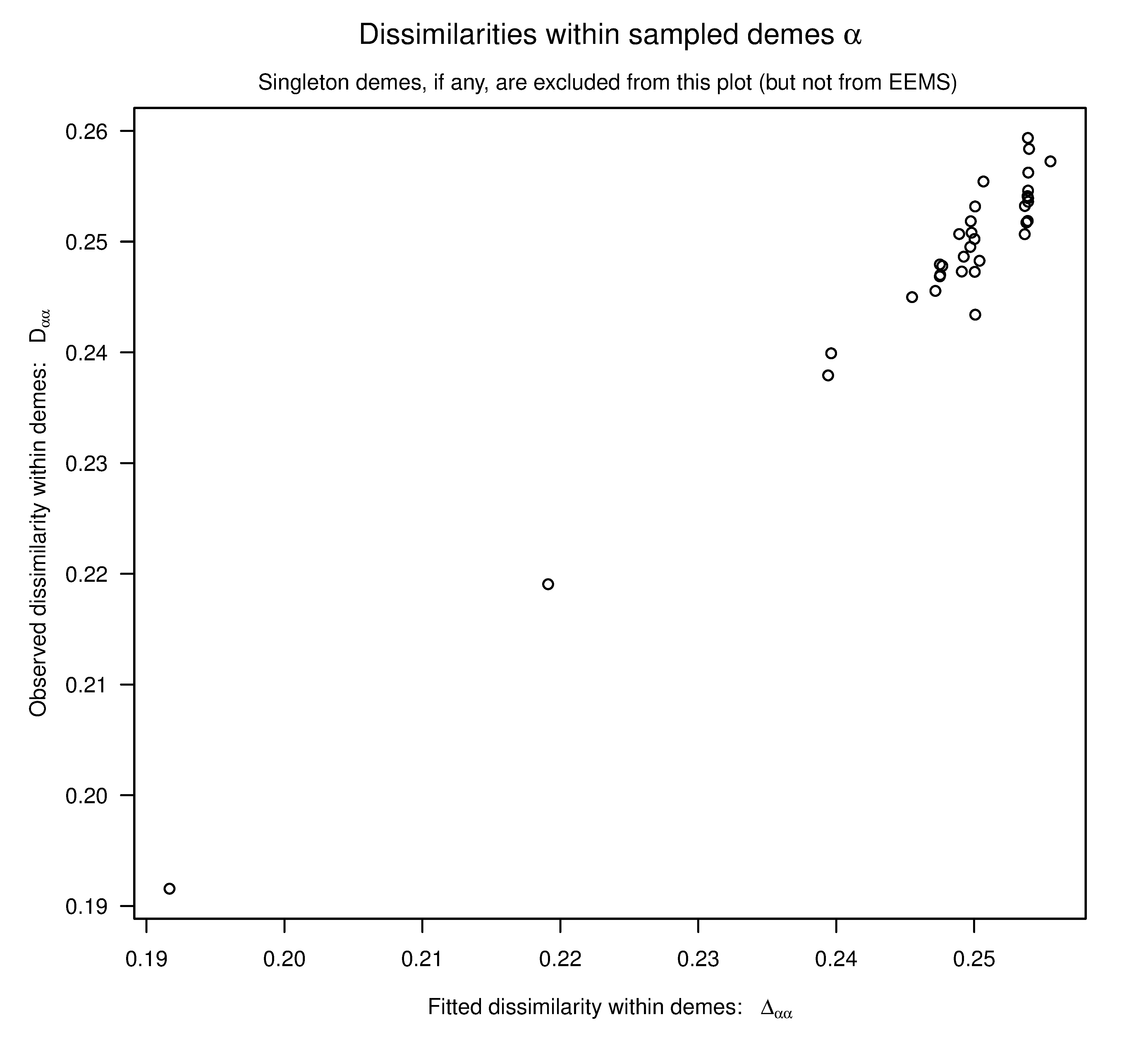
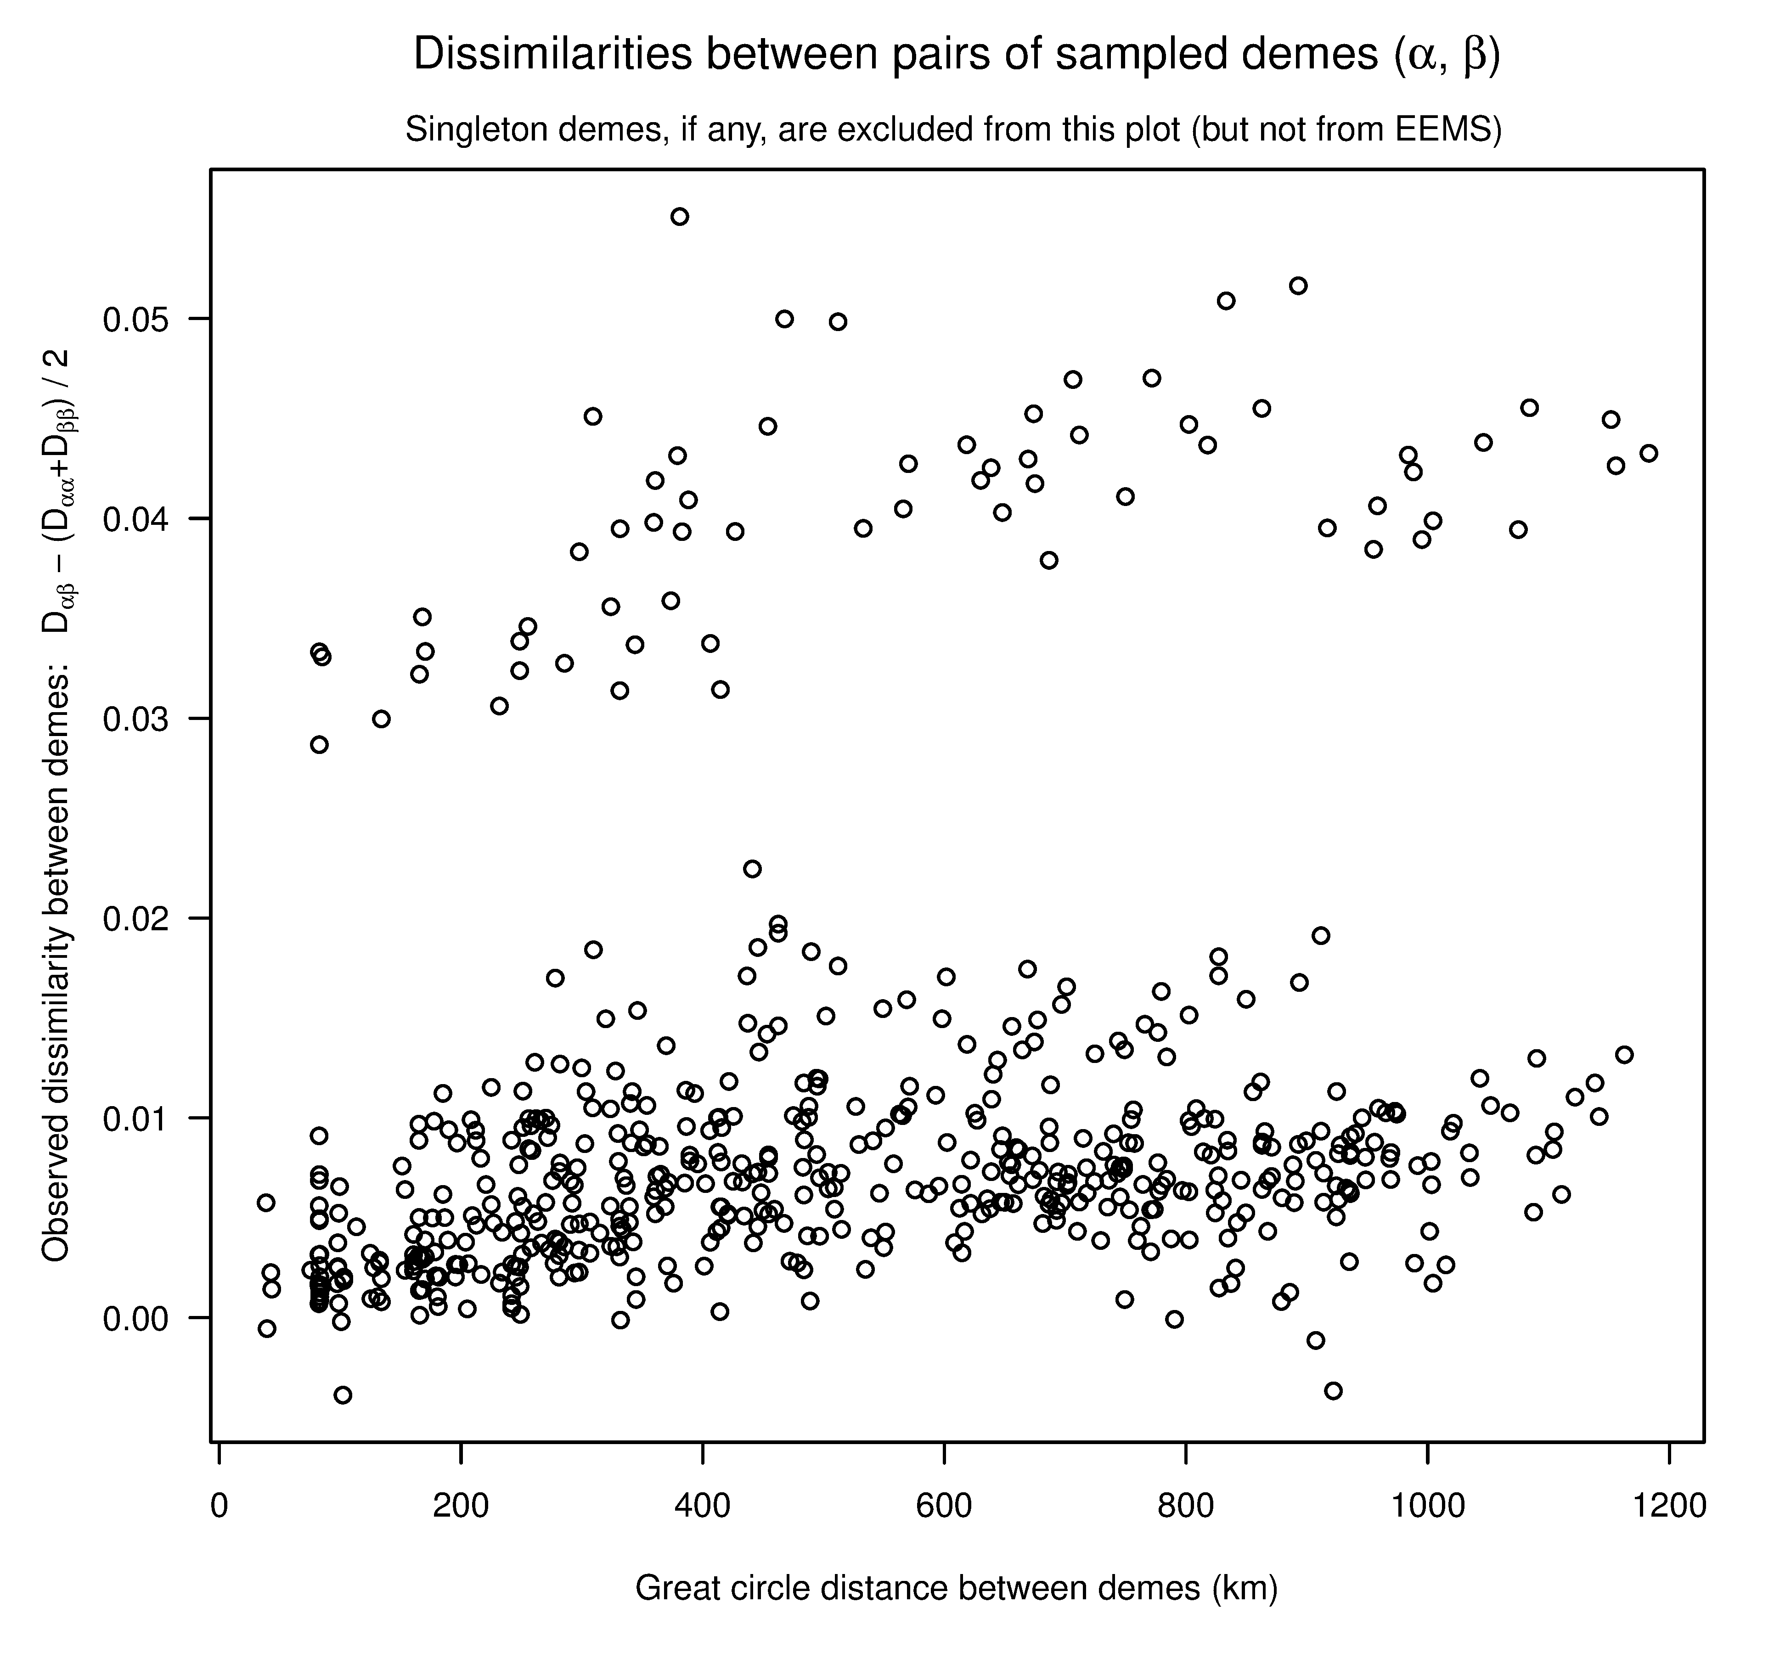
No trends, no autocorrelation
EEMS diagnostic plots
IBD
Notes:
runeems_snps --datapath idoteaNC --nDemes 200 --nIndiv 620 --nSites 100000 --numMCMCIter 2500000 --mcmcpath iNC --numThinIter 5000 --numBurnIter 1500000

